Slide 1
Lesson 4B
Uninformed Search.
Notes:
Part3.2 -Uninformed search

Slide 2
Uninformed Search
Uninformed search?
Uninformed search methods
  1. Depth-first search
  2. Breadth-first search
  3. Interactive deepening search
  4. Bi-directional search
Notes:
Part3.2 -Uninformed search

Slide 3
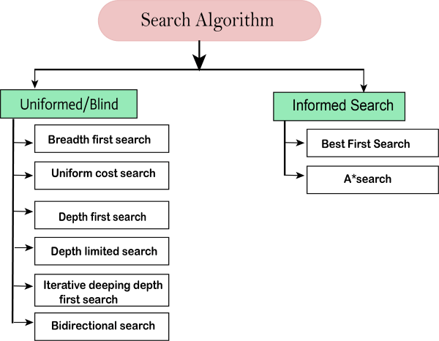
Uninformed Search?

Slide 4
Informed Search?
Informed search algorithms use domain knowledge.
In an informed search, problem information is available which can guide the search.
Informed search strategies can find a solution more efficiently than an uninformed search strategy.
Informed search is also called a Heuristic search.

Slide 5
Informed Search?
Informed search can solve much complex problem which could not be solved in another way.
An example of informed search algorithms is a traveling salesman problem.
  Greedy Search-Is an approach for solving a problem by selecting the best option available at the moment.
  A* Search- a simple and efficient search algorithm that can be used to find the optimal path between two nodes in a graph. It will be used for the shortest path finding
Notes:
Part3.2 -Uninformed search

Slide 6
Uninformed Search?
Uninformed search is a class of general-purpose search algorithms which operates in brute force-way.
Uninformed search algorithms do not have additional information about state or search space other than how to traverse the tree, so it is also called blind search.
Simply searches the state space (or NET).
Can only distinguish between goal state and non-goal state.
Sometimes called Blind search as it has no information or knowledge about its domain.

Slide 7
Uninformed Search Characteristics
Blind Searches have no preference as to which state (node) that is expanded next
The different types of blind searches are characterised by the order in which they expand the nodes.
This can have a dramatic effect on how well the search performs when measured against the performance measure

Slide 8
Uninformed (Blind) Search Methods
Methods that do not use any specific knowledge about the problem.
These are:
  Depth-first search
  Breadth-first search
  Non deterministic search
  Iterative deepening search
  Bi-directional search

Slide 9
1. Depth-first Search
Expand the tree as deep as possible, returning to upper levels when needed.
Depth-first search isa recursive algorithm for traversing a tree or graph data structure.
It is called the depth-first search because it starts from the root node and follows each path to its greatest depth node before moving to the next path.
DFS uses a stack data structure for its implementation.
The process of the DFS algorithm is similar to the BFS algorithm.

Slide 10
1. Depth-first Search
Advantage:
DFS requires very less memory as it only needs to store a stack of the nodes on the path from root node to the current node.
It takes less time to reach to the goal node than BFS algorithm (if it traverses in the right path).
Disadvantages
There is the possibility that many states keep re-occurring, and there is no guarantee of finding the solution.
DFS algorithm goes for deep down searching and sometime it may go to the infinite loop.

Slide 11
Depth-First Search

Slide 12
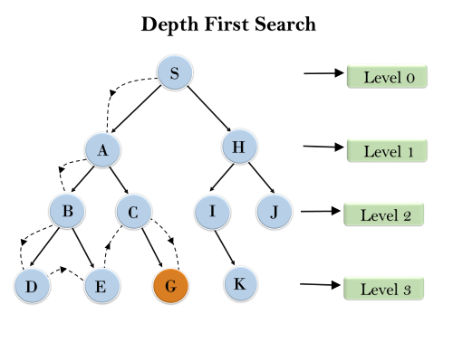
1. Depth-first Search

Slide 13
Depth-first search
= Chronological backtracking i.e go back after reaching deepest point.
S
Select a child
  convention: left-to-right
Repeatedly go to next child, as long as possible.
Return to left-over alternatives (higher-up) only when needed.
A
B
C
E
D
F
G

Slide 14
Evaluation criteria:
Completeness
  Does the algorithm always find a path?
    (for every state space such that a path exits)
Speed (worst time complexity) :
  What is the highest number of nodes that may need to be created?
Memory (worst space complexity) :
  What is the largest amount of nodes that may need to be stored?
Expressed in terms of:
    d = depth of the tree
    b = (average) branching factor of the tree
    m = depth of the shallowest solution

Slide 15
Completeness (depth-first)
Complete for FINITE (implicit) NETS.
  (= State space with finitely many nodes)

Slide 16
4
4
3
A
B
C
S
5
5
G
4
3
D
2
E
F
3
S
4
4
A
D
2
5
5
B
D
A
E
4
5
2
4
5
4
C
2
E
4
5
E
B
B
F
4
4
5
4
4
3
D
F
B
F
C
E
A
C
G
3
4
3
4
G
C
G
F
3
G

Slide 17
Speed (depth-first)
In the worst case:
  the (only) goal node may be on the right-most branch,
d
b
G
Time complexity == b^{d} + b^{d-1} + … + 1 = b^{d+1} -1
Thus: O(b^{d})
b - 1

Slide 18
Memory (depth-first)
Largest number of nodes in QUEUE is reached in bottom left-most node.
Example: d = 3, b = 3 :
...
QUEUE contains all nodes. Thus: 7.
In General: ((b-1) * d) + 1
Order: O(d*b) nb. B = expanded nodes, d = depth

Slide 19
2. Breadth-first Search
Breadth-first search is the most common search strategy for traversing a tree or graph.
This algorithm searches breadthwise in a tree or graph, so it is called breadth-first search.
BFS algorithm starts searching from the root node of the tree and expands all successor node at the current level before moving to nodes of next level.
The breadth-first search algorithm is an example of a general-graph search algorithm.
Breadth-first search implemented using FIFO queue data structure.

Slide 20
2. Breadth-first Search
Expand the tree layer by layer, progressing in depth.
In other words,
    Expand root node first
    Expand all nodes at level 1 before expanding level 2
    OR
    Expand all nodes at level d before expanding nodes at level d+1

Slide 21
Breadth-First Search

Slide 22
Breadth-first search:
S
A
Move downwards, level by level, until goal is reached.
D
B
D
A
E
C
E
E
B
B
F
D
F
B
F
C
E
A
C
G
G
C
G
F
G

Slide 23
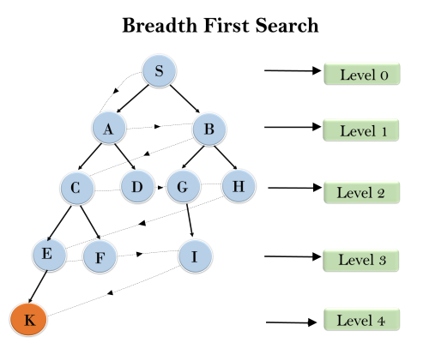
Breadth-first algorithm:
S---> A--->B---->C--->D---->G--->H--->E---->F---->I---->K

Slide 24
Breadth-first algorithm:
1. QUEUE <-- path only containing the root;
2. WHILE QUEUE is not empty
AND goal is not reached
DO remove the first path from the QUEUE;
create new paths (to all children);
reject the new paths with loops;
add the new paths to back of QUEUE;
3. IF goal reached
THEN success;
ELSE failure;
ONLY
DIFFERENCE !

Slide 25
Trace of breadth-first for running example:
(S) S removed, (SA,SD) computed and added
(SA, SD) SA removed, (SAB,SAD,SAS) computed, (SAB,SAD) added
(SD,SAB,SAD) SD removed, (SDA,SDE,SDS) computed, (SDA,SDE) added
(SAB,SAD,SDA,SDE) SAB removed, (SABA,SABE,SABC) computed, (SABE,SABC) added
(SAD,SDA,SDE,SABE,SABC) SAD removed, (SADS,SADA, SADE) computed, (SADE) added
etc, until QUEUE contains:
(SABED,SABEF,SADEB,SADEF,SDABC,SDABE,SDEBA,SDEBC, SDEFG) goal is reached: reports success

Slide 26
Completeness (breadth-first)
Complete
  even for infinite implicit NETS !
Would even remain complete without our loop-checking.
Note: ALWAYS finds the shortest path.

Slide 27
Speed (breadth-first)
If a goal node is found on depth m of the tree, all nodes up till that depth are created.
m
d
b
G
Thus: O(b^{m})
note: depth-first would also visit deeper nodes.
Notes:
Part3.2 -Uninformed search

Slide 28
Memory (breadth-first)
Largest number of nodes in QUEUE is reached on the level m of the goal node.
m
d
b
G
QUEUE contains all and nodes. (Thus: 4) .
In General: b^{m}
This usually is MUCH worse than depth-first !!
G

Slide 29
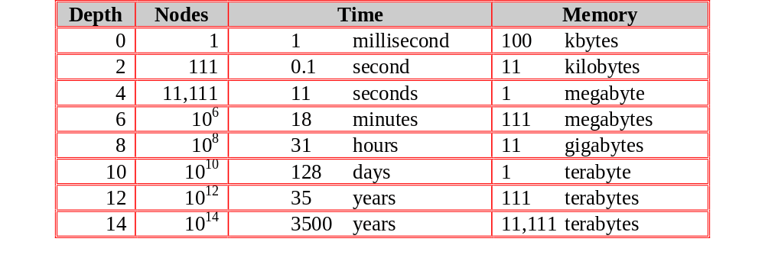
Exponential Growth (breadth-first)
Time and memory requirements for breadth-first search, assuming a branching factor of 10, 100 bytes per node and searching 1000 nodes/second

Slide 30
Exponential Growth - Observations
Space is more of a factor to breadth first search than time
Time is still an issue. Who has 35 years to wait for an answer to a level 12 problem (or even 128 days to a level 10 problem)
It could be argued that as technology gets faster then exponential growth will not be a problem. But even if technology is 100 times faster we would still have to wait 35 years for a level 14 problem and what if we hit a level 15 problem!

Slide 31
Practical evaluation:
1.Depth-first search:
  IF the search space contains very deep branches without solution, THEN Depth-first may waist much time in them.
2. Breadth-first search:
  Is VERY demanding on memory !
Solutions ??
  Non-deterministic search
  Iterative deepening

Slide 32
Practical evaluation:
Advantages:
BFS will provide a solution if any solution exists.
If there are more than one solutions for a given problem, then BFS will provide the minimal solution which requires the least number of steps.
Disadvantages:
It requires lots of memory since each level of the tree must be saved into memory to expand the next level.
BFS needs lots of time if the solution is far away from the root node.

Slide 33
Non-deterministic search:
1. QUEUE <-- path only containing the root;
2. WHILE QUEUE is not empty
AND goal is not reached
DO remove the first path from the QUEUE;
create new paths (to all children);
reject the new paths with loops;
add the new paths in random places in QUEUE;
3. IF goal reached
THEN success;
ELSE failure;

Slide 34
3. Interactive deepening Search
The iterative deepening algorithm is a combination of DFS and BFS algorithms.
This search algorithm finds out the best depth limit and does it by gradually increasing the limit until a goal is found.
This algorithm performs depth-first search up to a certain "depth limit", and it keeps increasing the depth limit after each iteration until the goal node is found.
Restrict a depth-first search to a fixed depth.
If no path was found, increase the depth and restart the search.

Slide 35
3. Interactive deepening Search
This Search algorithm combines the benefits of Breadth-first search's fast search and depth-first search's memory efficiency.
The iterative search algorithm is useful uninformed search when search space is large, and depth of goal node is unknown.
Advantages:
It combines the benefits of BFS and DFS search algorithm in terms of fast search and memory efficiency.
Disadvantages:
The main drawback of IDDFS is that it repeats all the work of the previous phase.

Slide 36
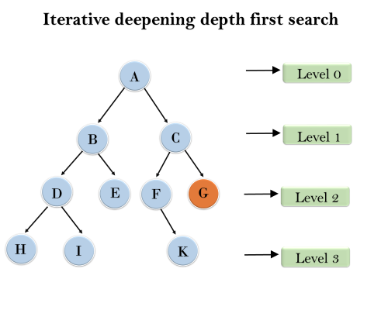
3. Interactive deepening Search

Slide 37
Interactive deepening Search
1'st Iteration-----> A
2'nd Iteration----> A, B, C
3'rd Iteration------>A, B, D, E, C, F, G
4'th Iteration------>A, B, D, H, I, E, C, F, K, G
In the fourth iteration, the algorithm will find the goal node.

Slide 38
Interactive deepening Search
Completeness:
This algorithm is complete is ifthe branching factor is finite.
Time Complexity:
Let's suppose b is the branching factor and depth is d then the worst-case time complexity is O(bd).
Space Complexity:
Let's suppose b is the branching factor and depth is d then the worst-case time complexity is O(bd).

Slide 39
Depth-limited search:
1. DEPTH <-- <some natural number>
QUEUE <-- path only containing the root;
2. WHILE QUEUE is not empty
AND goal is not reached
DO remove the first path from the QUEUE;
IF path has length smaller than DEPTH
create new paths (to all children);
reject the new paths with loops;
add the new paths to front of QUEUE;
3. IF goal reached
THEN success;
ELSE failure;

Slide 40
4. Bi-directional Search
Bidirectional search algorithm runs two simultaneous searches, one form initial state called as forward-search and other from goal node called as backward-search, to find the goal node.
Bidirectional search replaces one single search graph with two small subgraphs in which one starts the search from an initial vertex and other starts from goal vertex.

Slide 41
Bi-directional Search
The search stops when these two graphs intersect each other.
Bidirectional search can use search techniques such as BFS, DFS, DLS, etc.
Compute the tree from the start node and from a goal node, until these meet.

Slide 42
Bi-directional Search
Advantages:
Bidirectional search is fast.
Bidirectional search requires less memory
Disadvantages:
Implementation of the bidirectional search tree is difficult.
In bidirectional search, one should know the goal state in advance.

Slide 43
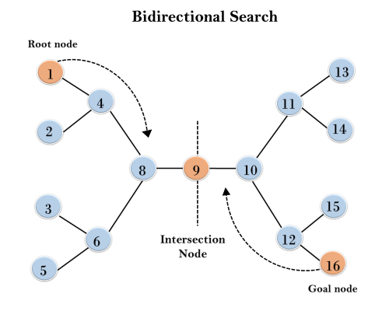
Bi-directional Search

Slide 44
Bi-directional Search
Completeness: Bidirectional Search is complete if we use BFS in both searches.
Time Complexity: Time complexity of bidirectional search using BFS is O(bd).
Space Complexity: Space complexity of bidirectional search is O(bd).
Optimal: Bidirectional search is Optimal.

Slide 45
Bi-directional search
IF you are able to EXPLICITLY describe the GOAL state, AND
you have BOTH rules for FORWARD reasoning AND BACKWARD reasoning:
Start
Goal

Slide 46
Bi-directional algorithm:
1. QUEUE1 <-- path only containing the root;
QUEUE2 <-- path only containing the goal;
2. WHILE both QUEUEi are not empty
AND QUEUE1 and QUEUE2 do NOT share a state
DO remove their first paths;
create their new paths (to all children);
reject their new paths with loops;
add their new paths to back;
3. IF QUEUE1 and QUEUE2 share a state
THEN success;
ELSE failure;

Slide 47
Properties (Bi-directional):
Complete: Yes.
Speed: If the test on common state can be done in constant time (hashing):
  2 * O(b^{m/2}) = O(b^{m/2})
Memory: similarly: O(b^{m/2})

